Slide 1
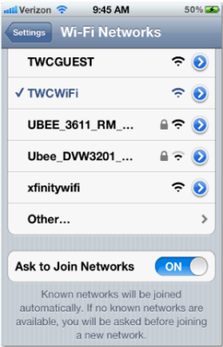
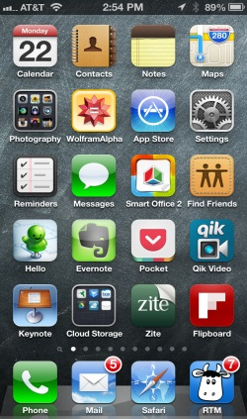
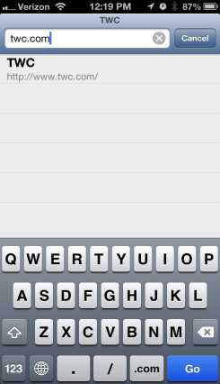
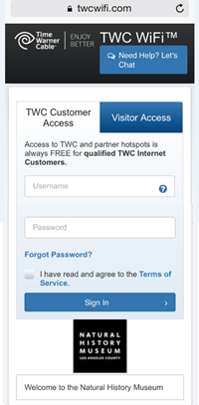
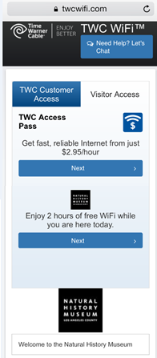
Connecting to TWC WiFi
1
Select TWCWiFi from the network list on your device
2
Open your browser and go to any website
The TWC WiFi sign in portal
will appear
If you are a TWC customer with standard Internet or above, sign in using your TWC ID.
If you are not a TWC customer, select the Visitor Access tab to begin your 2 hour Free Trial or purchase an Access Pass.
3
4
Follow the
sign in prompts and connect

