Slide 1
1st Step: Connect to TWCWiFi via the device’s native WiFi connection utility and open the browser.

Slide 2
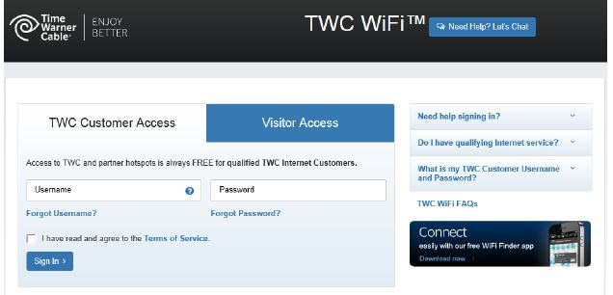
TWC subscribers and Visitor Login
Available to TWC business and residential customers with Standard Internet or above using TWC ID or Roadrunner credentials.

Slide 3
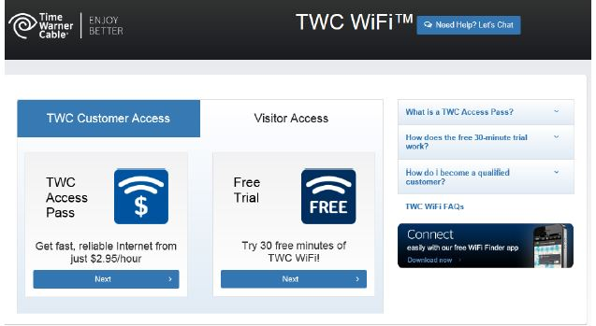
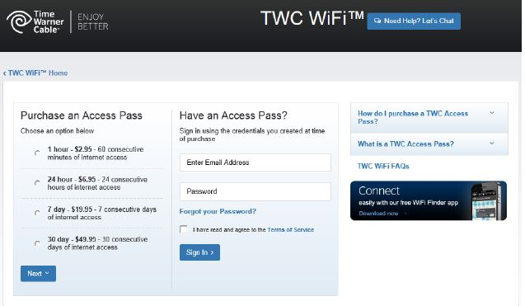
Prepaid Customer Access and Free Trial
For users seeking to access through the Prepaid Access Pass or 1 hour Free Trial option, they will find this login feature under the ‘Visitor’ tab

Slide 4
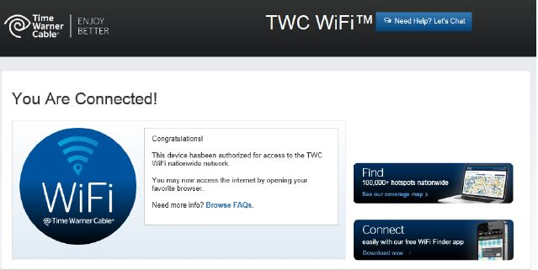
Successfully Connected!

Slide 5
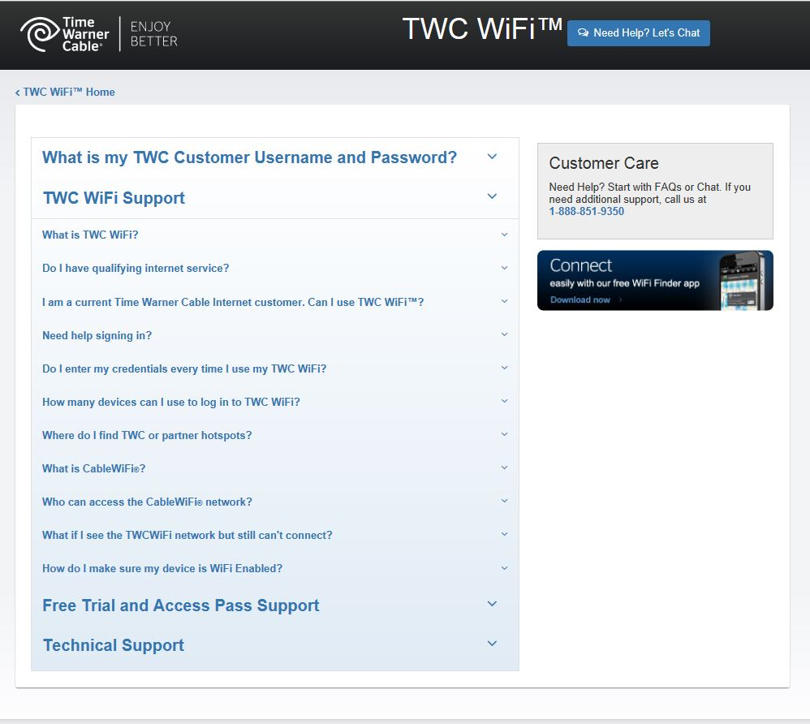
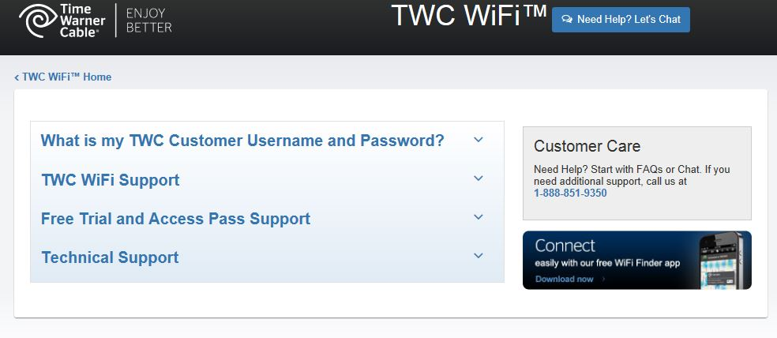
TWC WiFi Online Support www.twcwifi.com/support Extensive Online Customer Support, FAQs & Online Chat

